Slide 1


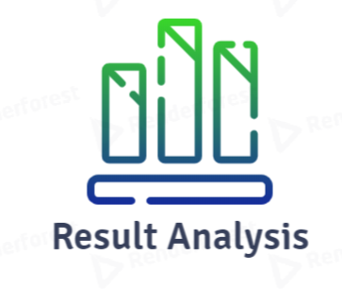
Result analysis
Presented By: Ayushi Patel(17CE069)
Meet Patel(17CE076)
Mihir Patel(17CE077)
Presented To: Prof. Trusha Patel

Slide 2
About the application
To analyze result basis on subject, class and grades
Shows graphical representation of the result
Takes in pdf and gives output in various pictorial format such as graphs, charts
Less GUI and more in backend
Data analysis of students grades using python libraries and Django framework

Slide 3
Functionalities
Viewing class result
Viewing subject wise result
Calculating the percentage (failed and passed students)
Making comparative analysis

Slide 4


Slide 5
Front-end : Django
WHY Django? -
Web framework
Rendering HTML

Slide 6
Backend
Python libraries

Slide 7
Coursework
Data analysis – DWDM
Django framework – python
Logic development and algorithm making – Data structure and algorithm / data analysis of algorithm

Slide 8
Roles
Ayushi Patel – Team leader & Backend developer
Meet Patel – Backend Developer
Mihir Patel – Data Analyst & Frontend Developer

